Slide 1

CGB1201 – JAVA PROGRAMMING
Department of Artificial Intelligence and Data Science
Academic Year: 2024 – 2025 (Odd Semester)
Register Number : 2303811724322041
Name : JANANI P
Year : II
Semester : III
Section : A
Date : 07/12/2024

Slide 2
Title of the Project
FOOD ORDERING
SYSTEM

Slide 3
Problem Identification
User Interface (UI) Usability Issues
Problem: The user interface might not be intuitive or easy to navigate, making it difficult for customers to place an order.
Handling Multiple Orders Simultaneously
Problem: In a real-time environment, the system might struggle to handle multiple orders simultaneously, leading to slow response times or errors.
Incorrect or Missing Item Selection
Problem: Users may select items incorrectly (for example, by clicking a checkbox by mistake) or leave required fields empty.
Order Confirmation and Communication
Problem: After placing an order, users might not receive immediate confirmation or updates regarding the status of their order.

Slide 4
Objective
User-Friendly Interface for customers to easily browse and place orders.
Accurate Order Processing to avoid errors and ensure timely fulfillment.
Real-Time Menu Updates to reflect the latest offerings and availability.
Secure Payment Integration for seamless and safe transactions.
Order Tracking and notifications to keep customers informed.
Customer Feedback for continual improvement and customer satisfaction.
Efficient Delivery System for timely and accurate deliveries.
Scalability and Reliability to handle high traffic and ensure continuous availability.

Slide 5
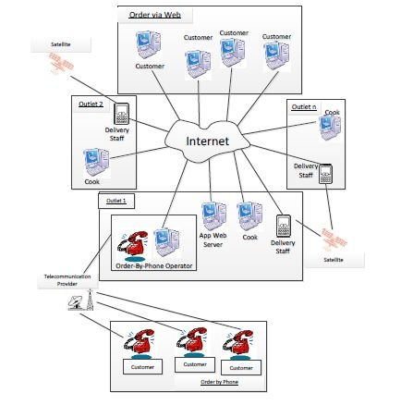
Proposed Architecture

Slide 6
Java Programming - Concepts Used
1.Swing (Graphical User Interface - GUI)
2.Exception handling
3.Data Structures (Collections)
4.Object-Oriented Programming
5.Multithreading
6.Payment Integration

Slide 7
List of Modules
1.User management module
2.Menu management module
3.Payment Integration module
4.Delivery Management module
5.Feedback and Support module

Slide 8
Module 1 Description
User Management Module This module handles user registration, login, and profile management. It ensures secure authentication and
maintains user preferences, order history, and saved addresses for a personalized experience.
Menu Management Module Designed for restaurant administrators, this module allows adding, updating, or removing food items, setting
prices, and managing item availability. It ensures customers have access to an updated menu.
Payment Integration Module Ensures secure and seamless transactions by supporting multiple payment methods such as credit/debit
cards, digital wallets, UPI, and cash on delivery.

Slide 9
Module 2 Description
Delivery Management Module Assigns orders to delivery personnel, optimizes delivery routes, and tracks deliveries to ensure timely
service. It may include GPS tracking for real-time updates.
Feedback and Support Module Enables customers to rate their experience, leave reviews, and contact customer support for resolving
issues or queries. This ensures continuous improvement and customer satisfaction.

Slide 10
Source Code
import javax.swing.*;
import java.awt.*;
import java.awt.event.ActionEvent;
import java.awt.event.ActionListener;
public class FoodOrderingSystem extends JFrame implements ActionListener {
private JComboBox<String> foodMenu;
private JTextField quantityField;
private JLabel totalLabel;
private String[] menuItems = {"Pizza - $8.99", "Burger - $5.99", "Pasta - $6.99", "Salad - $4.99"};
private double[] prices = {8.99, 5.99, 6.99, 4.99};
public FoodOrderingSystem() {
// Frame settings
setTitle("Food Ordering System");
setSize(400, 300);
setDefaultCloseOperation(JFrame.EXIT_ON_CLOSE);
setLayout(new GridLayout(5, 1));
// Components
JLabel menuLabel = new JLabel("Select Food Item:");
foodMenu = new JComboBox<>(menuItems);
JLabel quantityLabel = new JLabel("Enter Quantity:");

Slide 11
Source Code
quantityField = new JTextField();
JButton orderButton = new JButton("Place Order");
totalLabel = new JLabel("Total: $0.00", SwingConstants.CENTER);
// Add Action Listener
orderButton.addActionListener(this);
add(menuLabel);
add(foodMenu);
add(quantityLabel);
add(quantityField);
add(orderButton);
add(totalLabel);
setVisible(true);
}
@Override
public void actionPerformed(ActionEvent e) {
try {
int selectedIndex = foodMenu.getSelectedIndex();
int quantity = Integer.parseInt(quantityField.getText());
if (quantity < 1) {
JOptionPane.showMessageDialog(this, "Quantity must be at least 1.", "Error", JOptionPane.ERROR_MESSAGE);
return;
}

Slide 12
Source Code
double total = prices[selectedIndex] * quantity;
totalLabel.setText(String.format("Total: $%.2f", total));
JOptionPane.showMessageDialog(this, "Order placed successfully!\n" + totalLabel.getText(), "Success", JOptionPane.INFORMATION_MESSAGE);
} catch (NumberFormatException ex) {
JOptionPane.showMessageDialog(this, "Please enter a valid quantity.", "Error", JOptionPane.ERROR_MESSAGE);
}}
public static void main(String[] args) {
new FoodOrderingSystem();
}
}

Slide 13
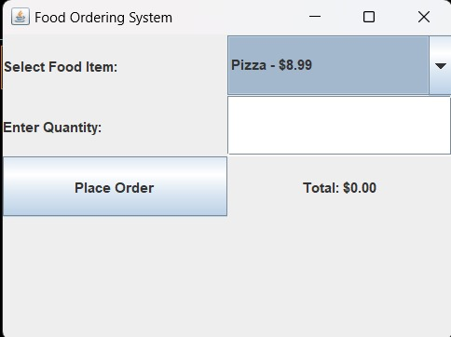
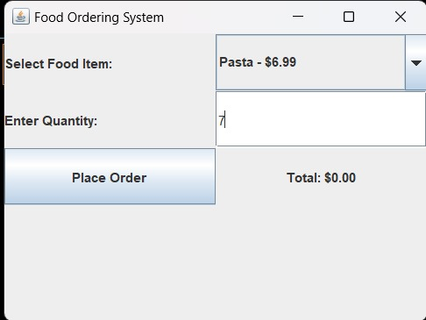
Results

Slide 14
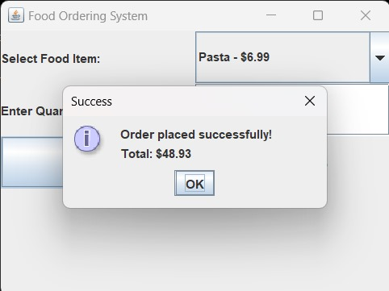
Results

Slide 15
Conclusion
In conclusion, the food ordering system represents a modern solution to the growing demand for online food delivery services, offering businesses a way to stay competitive and responsive to consumer needs. By leveraging advanced technology, restaurants can enhance customer satisfaction, improve operational workflows, and ultimately increase revenue. The development of such systems involves careful consideration of various components, such as user interface design, database management, payment systems, and integration with external services, ensuring a seamless and efficient user experience.

Slide 16
Thank You
Any queries???

